Slide 1
LoRa PODWave
Thibaud Vegreville / Loris Gentillion / Zheng Jian

Slide 2
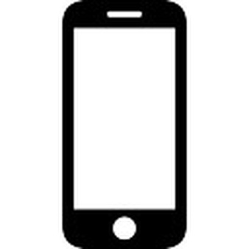
Global Structure
POD
POD
LEGENDE :
Protocole LoRa
Protocole WiFi
POD
Client
Client
Client

Slide 3
Implémentation Technique
Coté application mobile :
Coté POD :
Server et application WiFi :
Transmission LoRa :

